Slide 1


Programmez! DevCon #2
15-dec-2016
Accenture DevOps Platform dans Microsoft Azure
Pascal Sauliere
Architecte Infrastructure
Microsoft France
@psauliere
Sébastien Bro
Consultant DevOps
Accenture
@sbstnbr

Slide 2
Au programme
Automatisation avec Azure
ADOP : Accenture DevOps Platform
ADOP sur Azure

Slide 3
Automatisation dans Azure

Slide 4
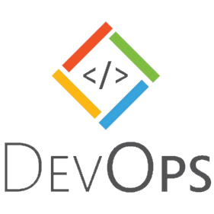

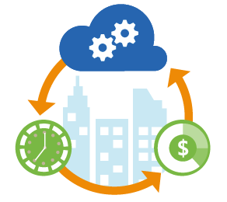
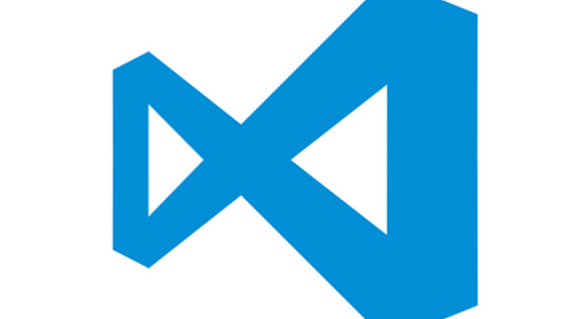
Infrastructure agile
Infrastructure as code
  Penser l’infrastructure comme un développeur pense son code
  Langages de scripts
  Langages déclaratifs
  Utiliser les méthodes et outils des développeurs : gestion des sources, versions
  Associer le dev et l’infra dans les dépôts de code
Orchestration
  Grouper les tâches automatisées – Orchestrator, Azure Automation

Slide 5
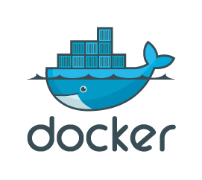
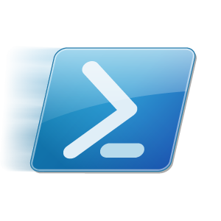

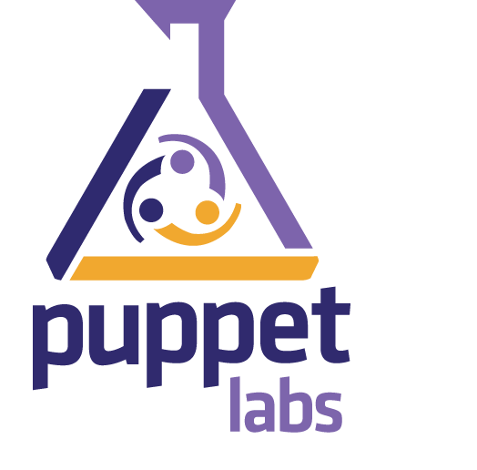
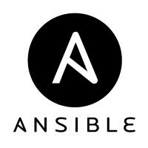
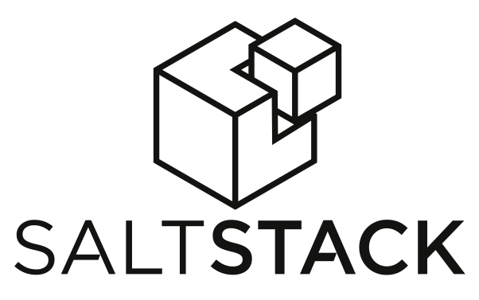
Provisionnement, déploiement
Provisionnement
  Virtualisation : CPU, mémoire, stockage, réseau
  Cloud : Azure Resource Manager, modèles JSON
  (Clusters de) serveurs de containers : Docker Machine, Docker Swarm, DC/OS, Kubernetes
Déploiement
  Gestionnaires de packages : APT, PackageManagement, PowerShell Gallery, Chocolatey, NuGet, Docker Hub, Docker Trusted Registry…
  Containers et clusters de serveurs de containers : Docker
  Configurations déclaratives : PowerShell DSC, Chef, Puppet, Ansible, Salt Stack
  Tests automatisés (Pester)

Slide 6
Azure Resource Manager (ARM)
Principaux concepts :
  Groupes de ressources : frontière du cycle de vie d’une application
  Ressources : tout ce que l’on peut trouver dans Azure – VM, Web app, base SQL Azure…
  RBAC : groupes d’utilisateurs, rôles, permissions sur groupes de ressources
  Tags : (clés, valeurs) sur ressources ou groupes de ressources
  Policy : restrictions sur ressources
  Templates : définition déploiement et configuration de vos application
Bénéfices
  Simplicité de l’administration – tags pour reporting, facturation, conformité, audit
  Template déclaratif – qualité et simplicité
  Idempotence – déploiements répétables et cohérents
  Passage à l’échelle et parallélisme

Slide 7
Azure Resource Manager - Groupe de ressources
Entité de gestion dans laquelle sont intégrés des regroupements de multiples ressources de même type ou non.
L’appartenance à un groupe de ressources est exclusive
Peuvent être multi-régions
RESOU
R
CE G
R
OUP

Slide 8
Azure Resource Manager - Notion de template
Solution déclarative de déploiement et configuration d’un groupe de ressources
Configuration des ressources, de leurs dépendances, de leurs interconnexions
SQL-A
Website
[SQL CONFIG] VM (2x)
DEPENDS ON SQL
DEPENDS ON SQL
SQL - A
Website
Virtual
Machines
SQL
C
ONFIG

Slide 9
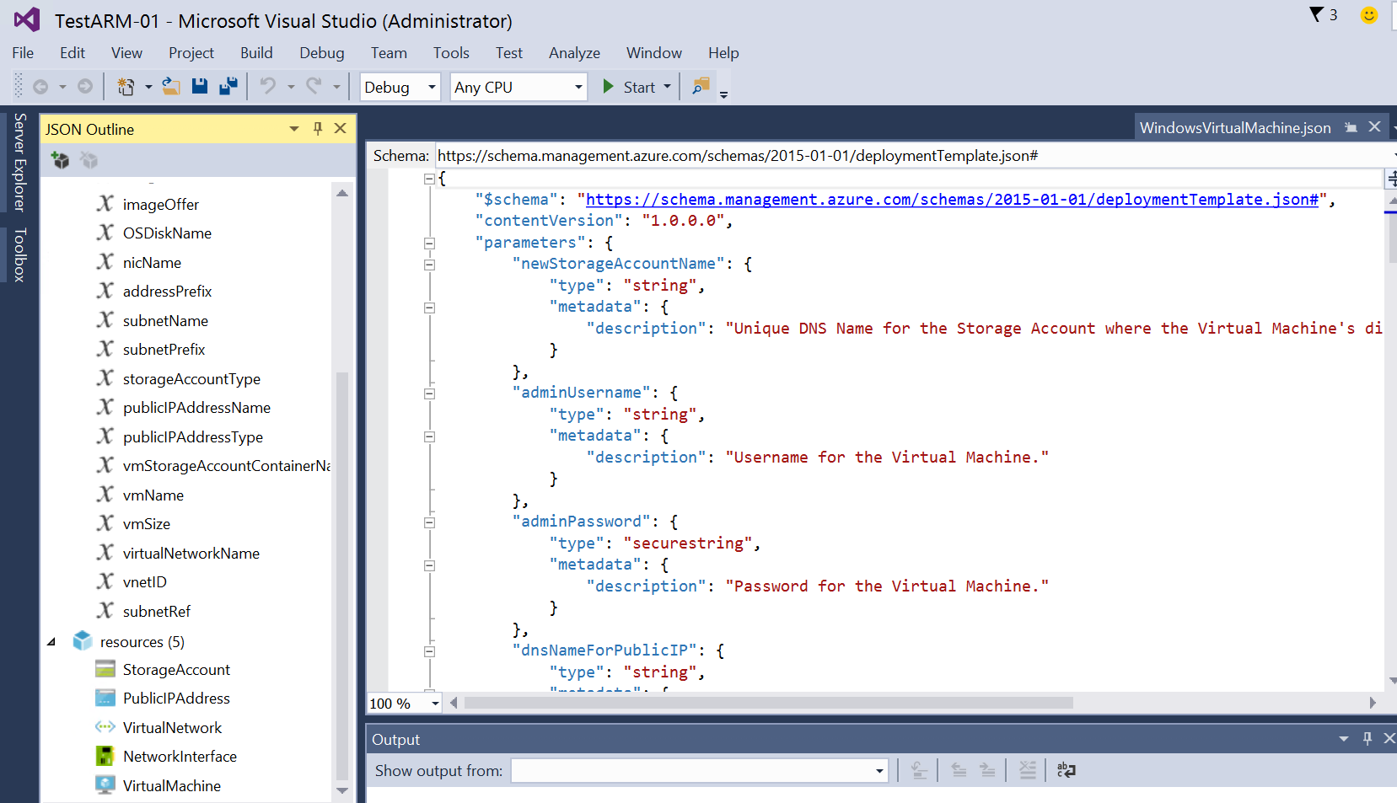
Azure Resource Manager - Notion de template
Fichier JSON géré dans un contrôleur de source
Idempotence
Retour sur une version antérieure
Notes:
S

Slide 10
Options de déploiement
Portail Azure
PowerShell
Azure CLI
Visual Studio
VSTS release
Azure Automation
Azure DevTest Labs

Slide 11
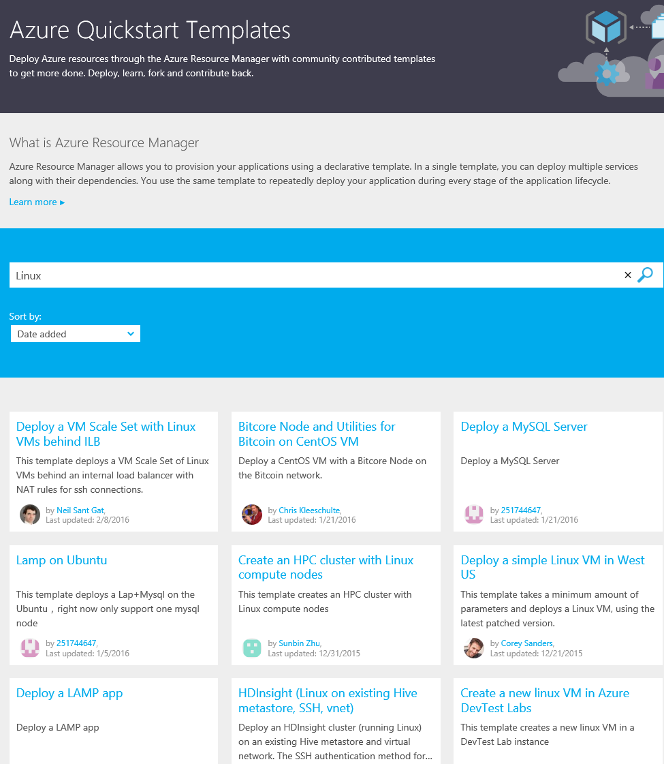
Azure Quickstart Templates
Grand choix d’exemples de modèles pour démarrer :
http://azure.microsoft.com/en-us/documentation/templates/
https://github.com/Azure/azure-quickstart-templates
Documentation :
https://azure.microsoft.com/en-us/documentation/templates/
Notes:
Get-AzureResourceGroupGalleryTemplate
https://github.com/Azure/azure-quickstart-templates
<template>.json - This is the main template file
<tempalte>.parameters.json - The parameters that can be passed to the template and while optional provides a way to prepopulate values that can be passed when creating an instance of the template
metadata.json - Data about the template used by Azure to enable its use and publication
README.md - Information about the template and often a button that deploys the template to Azure by loading the template into the template editor in the Azure portal
http://windowsitpro.com/azure/how-do-i-use-template-create-vms-azure-iaas-v2-arm

Slide 12
Dans le cloud public ou privé
App Innovation
Windows Server
Linux
Windows Server
Linux
Hybrid
Hyper-scale
Enterprise-grade
Portal
IaaS | PaaS services
Portal
IaaS | PaaS services
Cloud-inspired infrastructure
Powered by Windows Server, Hyper-V,
System Center, and Azure technologies
Cloud infrastructure
Microsoft Azure Stack
Datacenter
Microsoft Azure
Notes:
P

Slide 13
ADOP
Accenture DevOps Platform

Slide 14
What is ADOP?
Accenture DevOps Platform
Collection of pre-configured Open Source development tools to mobilize software development projects in a fast, robust and consistent way
Development
Source Control
Code Review
Build
Code Quality
Deploy
Testing
A/B Test
Cloud-based hosting and access to application services through Accenture Cloud Platform
Release
Cloud-hosted development environment integrated to source code repository via code review server
Autonomous build and testing of code submissions
Continuous Integration
Quality gates enforced using standardized tests against re-usable components and libraries Continuous Delivery
Managed roll-out of new features via A/B testing
Continuous Deployment
Integrated Development Environment (Eclipse, X-code)
Source Code Repository
(Git / Gerrit)
Continuous Integration (Jenkins)
Code Analysis (Sonar and Black Duck)
Deploy
(Chef and Docker)
Test
(Selenium, Grid, Cucumber)

Slide 15



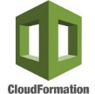



A brief history of ADOP
Starting as a training enablement tool, ADOP has evolved significantly both in functionality and technology as we have embraced technological advances.
1
2
3
4
5
6
Tools in the Cloud (Monsoon)
DOMO / Single ADOP Platform
(DevOps Academy Lab)
Blueprints (nested cloud formation)
Cartridges (cloud-formation + configuration package)
Docker Orchestration
Docker Orchestration
Server Configuration Management
Server Orchestration
Version 2
None.
Single Platform
Embedded Tabs
Blueprints
(Nested Cloud-Formation)
Cartridges
(Data Import +
Nested Cloud-Formation)
Cartridges
Platform Extensions
Cartridges
Platform Extensions
Extension Architecture
ACP Blueprint Support
Azure Support
Multi-Tenancy
Support
Workspaces
Open Sourced
Community Edition
Enterprise Edition
Other
Enhancements
Copyright © 2015 Accenture All rights reserved.
15

Slide 16
3 flavours of ADOP
“M” : The managed multi-tenancy platform
“F” : Fleet, the managed single-tenancy platform
“B” : B…, on your own infrastructure and managed by you
2 new sub-flavors upcoming
Community Edition: Full OSS
Enterprise Edition: Includes Atlassian

Slide 17







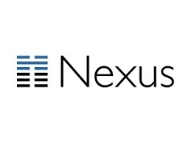




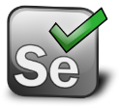

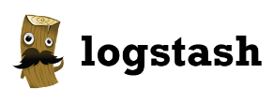

ADOP – The Tools
Notes:
Taken from https://adlm.accenture.com/wiki/display/DOT/Architecture - is this out of date?

Slide 18
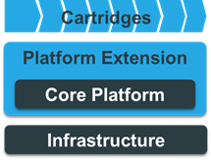
Component Overview
Three main components:
  Core – the bundle of pre-configured tools in ADOP/B
  Cartridges
  Platform Extensions
Cartridges
Standardised approach of packaging and sharing reusable software delivery assets
Defines the Git repositories with sample code, Jenkins jobs and pipelines that define a reference implementation for a particular technology
Platform Extensions
Provides the ability to extend the Core and add new tools or extensions to existing tools
For example:
Jenkins plugins
Sonar plugins
Tools (via Docker or EC2)
…the list goes on
  If it’s not in the Core and it could be used by multiple cartridges, it is probably a platform extension

Slide 19
Upstream Contributions
Projects are welcome to contribute plugins or platform extensions:
Cartridge examples: FOSS Java, FOSS JavaScript, Drupal, Oracle, Mule, SAP, etc.
Platform Extension examples: AWS, DockerSwarm, Ms ARM, CucumberPlugin,

Slide 20
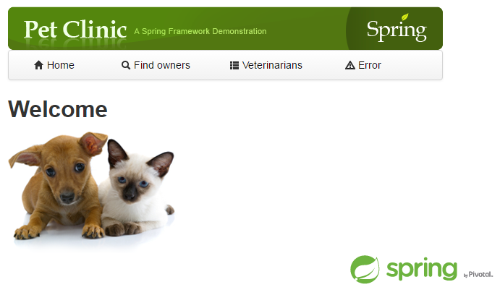
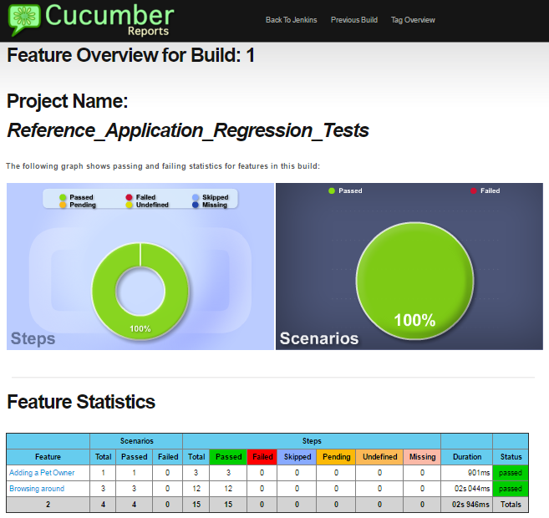
Key Links
ADOP: https://github.com/Accenture/adop-docker-compose
Java Cartridge: https://github.com/Accenture/adop-cartridge-java
Gitter: https://gitter.im/Accenture/ADOP
https://www.accenture.com/us-en/blogs/blogs-open-sourcing-accenture-devops-platform

Slide 21
ADOP dans Azure

Slide 22
Objectif
Ajouter Azure comme option de déploiement d’ADOP
Respecter le principes d’ADOP :
  Déploiement automatisé
  Shell scripts, Docker Machine, Docker Compose
  Open Source
Quelques jours de collaboration

Slide 23
Résultats
Méthode 1 : Script et Docker Machine
Méthode 2 : ARM Templace
Méthode 3 : cluster Azure Container Service en mode Docker Swarm

Slide 24
Démo !

Slide 25
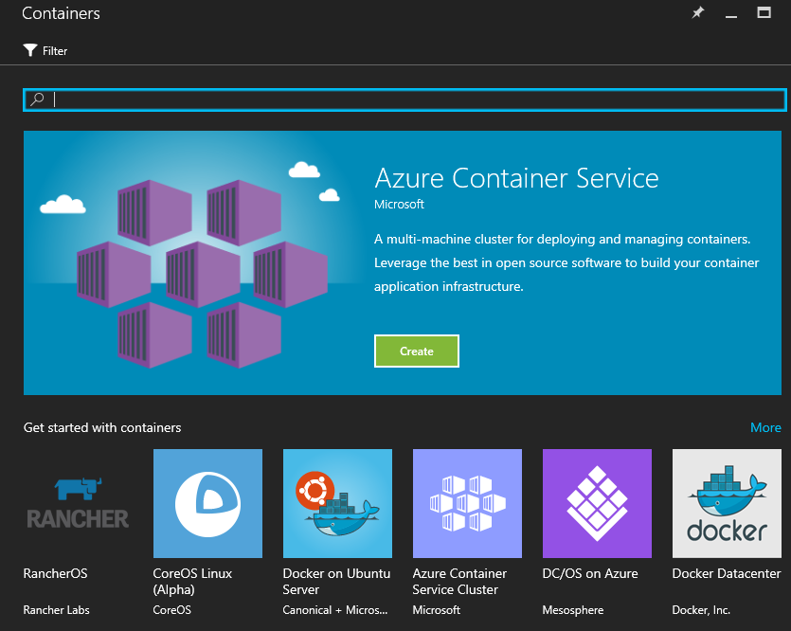
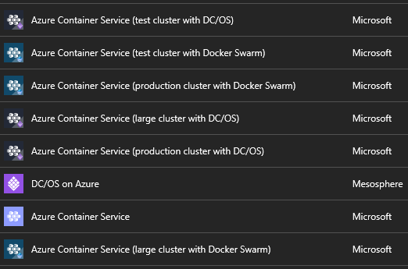
Docker dans Azure
Docker on Ubuntu Server
Docker VM extension
Docker Machine
Azure Container Service
DC/OS on Azure
Docker for Azure
Docker Datacenter

Slide 26
Liens utiles
Documentation ARM templates : https://azure.microsoft.com/en-us/documentation/templates/
“Fork” de ADOP avec méthode 1 :
https://github.com/pascals-msft/adop-docker-compose
Template ARM pour méthode 2 : https://github.com/pascals-msft/adop-arm

Slide 27


Retrouvez-nous sur Twitter et autres
Pascal Sauliere
Sébastien Bro
http://aka.ms/pascals
http://aka.ms/itcast
Twitter : @psauliere
Twitter : @sbstnbr

