Slide 1
Bien démarrer avec Raspberry Pi Et les Cognitive Services
Aymeric Weinbach
DEVCON #4

Slide 2
Meet the Team
Aymeric Weinbach
@aymericw

Slide 3
Microsoft Cognitive Services
Vision
From faces to feelings, allow your apps to understand images and video
Cognitive Services
Give your solutions a human side
Speech
Hear and speak to your users by filtering noise, identifying speakers, and understanding intent
Language
Process text and learn how to recognize what users want
Knowledge
Tap into rich knowledge amassed from the web, academia, or your own data
Search
Access billions of web pages, images, videos, and news with the power of Bing APIs
Notes:
What are Cognitive Services? Microsoft Cognitive Services are a new collection of intelligence and knowledge APIs that enable developers to ultimately build smarter apps.

Slide 4
Smarter Raspberry Pi with Cognitive Services
VISION
SPEECH
LANGUAGE
KNOWLEDGE
SEARCH
Recognize people and things
Give me directions to El Gaucho
Play today’s Daily Show
Show me the top economics
journals
Search for ‘cute kittens’
Computer vision
Speech-to-text and text-to- speech service
Natural language processing
Knowledge exploration service
Bing search

Slide 5
microsoft.com/cognitive
Vision
Speech
Language
Knowledge
Search
Computer Vision
Custom Recognition
Bing Spell Check
Academic Knowledge
Bing
Web Search
Emotion
Speaker Recognition
Linguistic Analysis
Entity Linking
Bing
Image Search
Face
Speech
Language Understanding
Knowledge Exploration
Bing
Video Search
Video
Text Analytics
Recommendations
Bing
News Search
Content Moderator
WebLM
QnA Maker
Bing
Autosuggest
Translator

Slide 6
Why Microsoft Cognitive Services?
Easy
Flexible
Tested
Roll your own with REST APIs
Simple to add: just a few lines of code required
Integrate into the language and platform of your choice
Breadth of offerings helps you find the right API for your app
Built by experts in their field from Microsoft Research, Bing, and Azure Machine Learning
Quality documentation, sample code, and community support
GET A KEY
BUILD

Slide 7
Analyze image
Vision APIs
Category | People; 1 face found
Adult / Racy? | False / True
Black & White? | No
Dominant colors
Accent color
Analyze an Image – Understand content and features within an image for a growing set of categorization
Wide range of concepts from cat to fireworks
OCR – Detect and recognize words within photos or scanned documents
Generate Thumbnail – Scale and crop an image, while retaining key content
Powers Bing Image search and OneDrive.com Photos
OCR
Recognized text:
A GOAL WITHOUT
A PLAN IS
JUST A WISH
Smart thumbnail
Notes:
Examples – Useful for moderating UGC

Slide 8
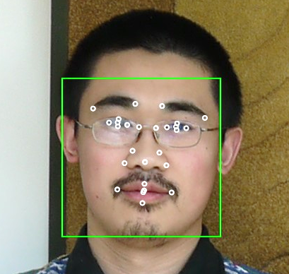
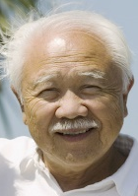
Detection Result
Face APIs
Face Rectangle – width; height; left; top
Attributes:
Age – 31
Gender – Male
Face Landmarks –pupil, nose, mouth
DETECTION
ATTRIBUTES
INPUT IMAGE
Face Detection – Detects faces and their attributes within an image
Face Verification – Check if two faces belong to the same person
Similar Face Searching – Find similar faces within a set of images
Face Grouping – Organize many faces into groups
Face Identification – Search which person a face belongs to
Models used to power Microsoft Skype & Windows Hello
Grouping
Identity
He is Chao Wang…
IDENTIFY
Natalie Huber
NEW INPUT IMAGE
RECOGNITION
Chao Wang
COLLEAGUES

Slide 9
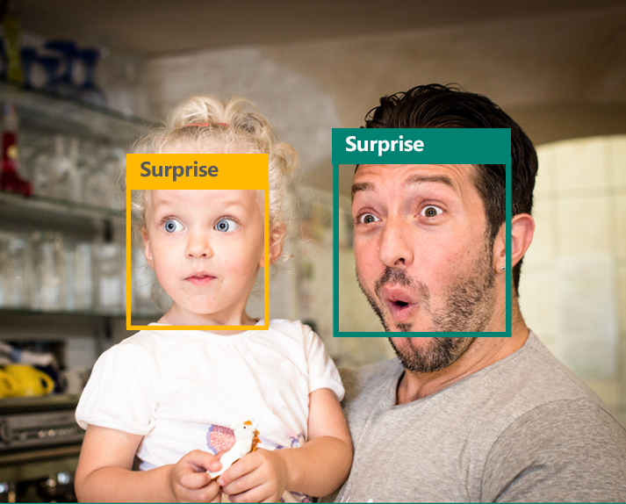
Emotion APIs
Identifies emotions based on expressions that psychologic research identifies as universal: Happiness, Surprise, Sadness, Anger, Fear, and Disgust
Has been trained to identify emotions in-the-wild.
A solution for analyzing individual responses to media and products, to crowd analytics, and to enhanced personalization
Get insights into how your users react to content and experiences
Track facial expressions for multiple users over time.

Slide 10
Video APIs
Stabilization – Smooth and stabilize shaky video
Face Detection and Tracking – Detect and track faces in videos
Motion Detection – Detect when motion occurs

Slide 11
Speech APIs
State of the art algorithms to process spoken language
Voice Recognition – Converts spoken audio to text
Support for 18 languages (28 locales)
Voice Output – Synthesize audio from Text
Support for 9 languages (17 locales)
Powered by Bing, which is the same backend for Xbox and Cortana on Windows Phone 8.1 and Windows 10
Speech
Recognition
Speech Intent Recognition
Text to Speech Conversion
450 6th St. San Francisco
"450 sixth St in San Francisco."
"For 50 six St San Francisco."
"456th St San Francisco."
Convert spoken audio to text
Convert audio to intent
Convert text to spoken audio

Slide 12
Choisir un Os
Raspbian
Windows 10 IoT

Slide 13
Windows 10 IoT
UWP app en C#
Environnement de Dev Visual Studio
Deploy avec Visual Studio

Slide 14
Raspbian
Télécharger et coller une image sur raspberry pi

Slide 15
Sdk C#
Cognitive Vision
DotNetCore: https://github.com/Microsoft/Cognitive-Vision-DotNetCore

Slide 16
Sdk Python
Vision Api https://github.com/Microsoft/Cognitive-Vision-Python
Face Api https://github.com/Microsoft/Cognitive-Face-Python
Emotion Api https://github.com/Microsoft/Cognitive-Emotion-Python
Luis https://github.com/Microsoft/Cognitive-LUIS-Python
Speaker Recognition https://github.com/Microsoft/Cognitive-SpeakerRecognition-Python

Slide 17
Sdk Node.js
Unofficial Sdk par Josh Balfour : https://github.com/joshbalfour/node-cognitive-services

Slide 18
Nous suivre
Facebook
LinkedIn
facebook.com/groups/azugfr/
Linkedin.com/inspirasign
Twitter
Web
twitter.com/AZUGFR
www.azug.fr
Meetup
meetup.com/AZUG-FR/

Slide 19
Merci
d’être venus
A bientôt !

